Slide 1
Blended Learning
Wednesday, March 15, 2023

Slide 2
Agenda
What is blended learning?
Why is it important/useful?
Who benefits?
When should it be used?
  Two scenarios

Slide 3
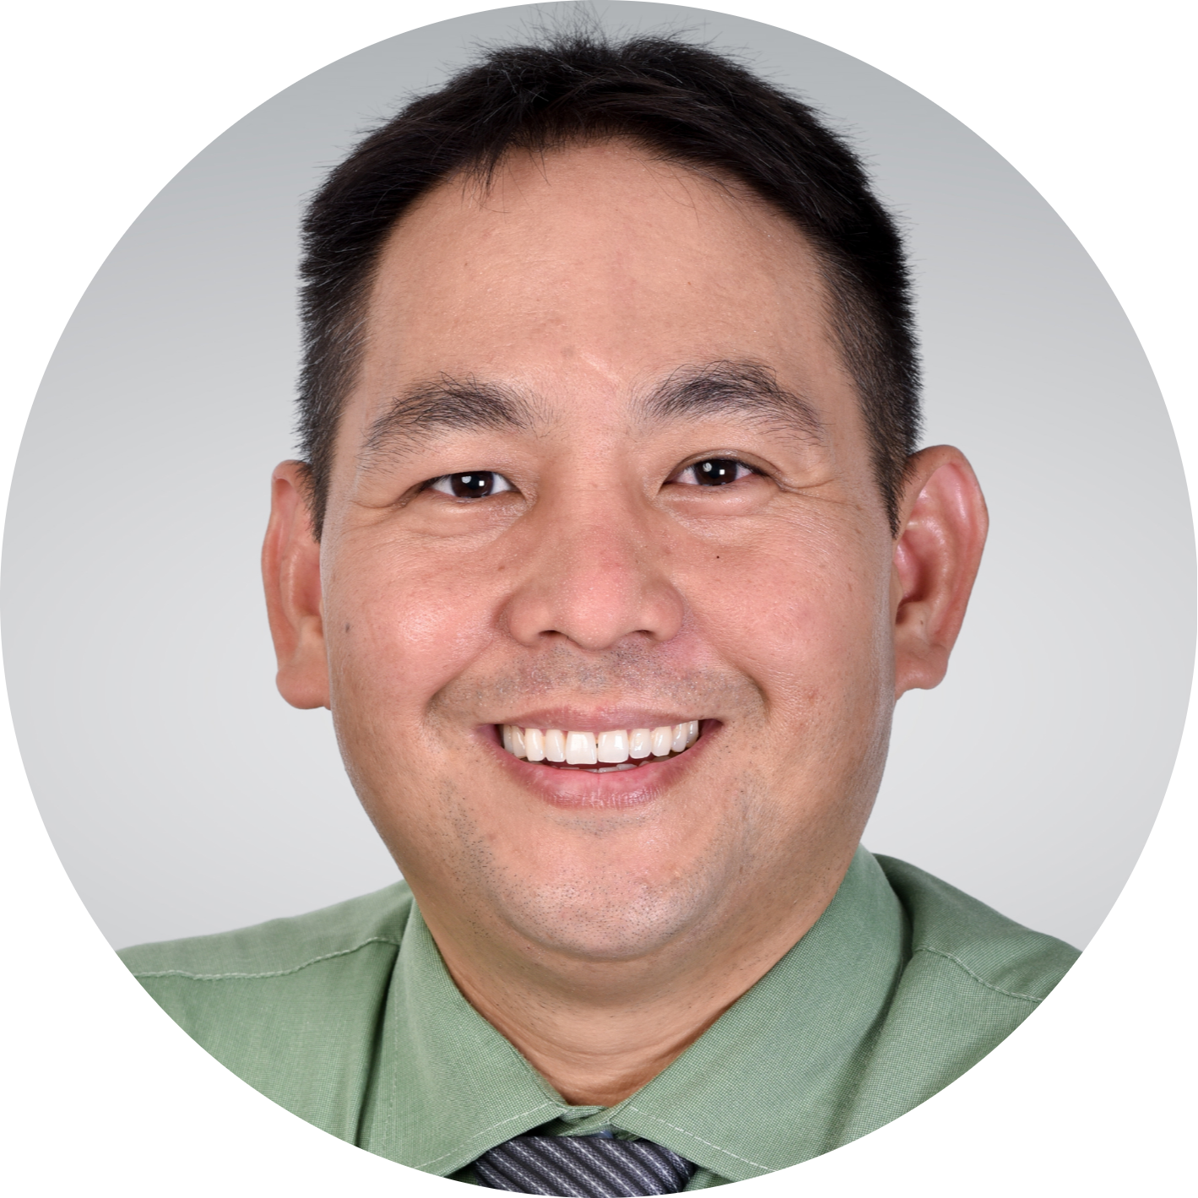
About Me
Born in US, parents are Filipino and Korean
Early childhood teacher, Elementary Principal, High School Principal and Head of School/Executive Director
Doctorate in Educational Leadership
Executive Director and Elementary Principal

Slide 4

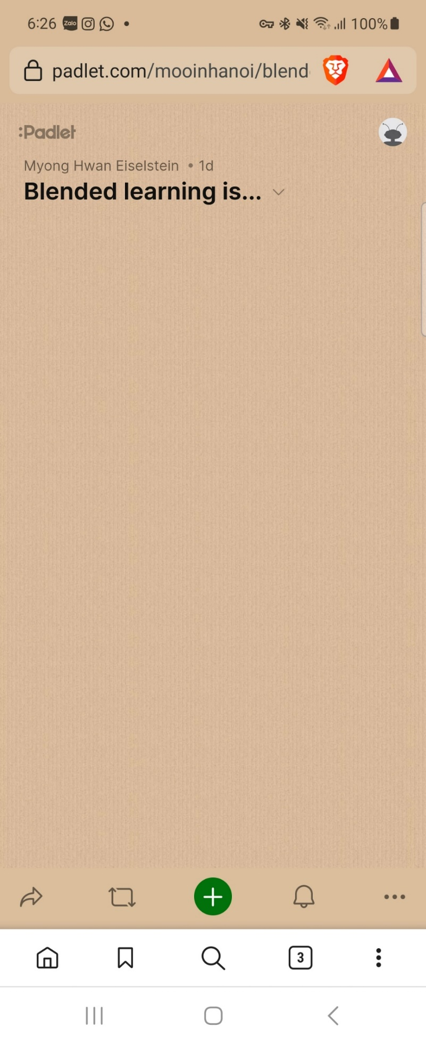
What is blended learning?
“Blended learning is…”
padlet.com/mooinhanoi/blended_learning

Slide 5
Blended learning is…
“…when traditional methods of teaching are combined with online learning to provide a flexible learning experience.”

Slide 6
Why use blended learning?
Required to e.g. COVID-19 lockdowns
  It’s different than full online learning
Learning is different now
Meet the individual needs of students

Slide 7

Advantages of Blended Learning
It’s accessible:
  Classes can be accessed from smart phones and tablets (along with normal computers and laptops)
  Internet connectivity is everywhere
  Teachers share resources
It’s flexible:
  Flipped classrooms
  Differentiated assignments
  Your imagination is the only limit
Prepares our students for future learning

Slide 8
Things to consider…
Time consuming
  Feedback takes longer (if not face to face)
  Individual or group meetings (if not face to face)
Lot of work
  More time to prepare
  Differentiated lessons
  Less online time = more online communication

Slide 9
Who benefits from blended learning?
Students
Parents
Teachers
Organizations

Slide 10

Practical Use – Two Scenarios
Optional Blended Learning
Required Blended Learning

Slide 11
Optional Blended Learning – Debating Ukraine
Citizenship and Government
Demonstrate skills that enable people to monitor and influence state, local and national affairs.
For example: Working with others; conducting civil conversations; articulating ideas and interests; negotiating differences and managing conflict with people or groups who have different perspectives; using parliamentary procedures; building consensus.

Slide 12
For and Against
Students were divided into two groups:
In favor of the US providing additional aid to Ukraine
Opposed to providing additional aid to Ukraine
Plan:
Each team prepared a presentation to support their target
Teams presented their ideas to the entire class
Each team prepared a rebuttal presentation
I selected the winner based on the competition rubric

Slide 13
For and Against cont.
Flipped Classroom:
Homework/Online:
  Students received instruction on the purpose of debate and civil discourse
  Students learned about the Russia and Ukraine war
  Students learned aid facts about the war
  Students given grading rubric and opportunity to ask questions through Google Classroom
In-person:
  Students planned their presentations, gave each other tasks, asked questions
  Students conducted research together
  Teacher “walked the room” to assist students and ensure they were on task

Slide 14
For and Against cont.
At the end of the lesson, students conducted anonymous feedback for each other using rubrics
Students completed an Exit Ticket to show what they learned
Students provided feedback to improve future experiences

Slide 15
Online Learning When Required
Well-being
  Students and teachers cannot spend all day in front of a computer
  Lack of socialization can lead to depression and anxiety
  Prolonged screen time can cause physical problems (eyesight, posture)
  The goal is to learn – EARCOS example
Maximize real-time instruction and individual learning
Mix up the activities and resources

Slide 16
List of online apps
Google Apps: office suite, forms, classroom, Meets
Social apps: Twitter, Facebook, TikTok, Instagram
Kahoot!
Padlet

Slide 17
Practical Exercise
Think of an upcoming lesson (or a recent one that you just taught)
How can you turn it into a hybrid/blended learning lesson?
Spend the next few minutes transforming it to a blended learning lesson:

Slide 18
Practical Exercise cont.
Remember:
  Your objectives: how can you use online and offline resources to make your lesson more engaging?
  Maximize your time: what can the students do on their own? How can you use your in-person time wisely?
  Use your resources to meet the individual needs of your students.
  How can you use your resources to increase collaboration among students?
  How will you assess student work?

Slide 19
If you want feedback…
Email: executive.director@stpaulhanoi.com

Slide 20

One thing I learned about blended learning…
#BlendedLearningHanoi

